Slide 1
Get your data back under control or 200 things you can do with Nextcloud
Notes:
Welcome everybody

Slide 2
Agenda
The awesome cloud
The awful cloud
This thing called privacy
  “I have nothing to hide”
Nextcloud
200 things and more
Notes:
Good and bad of cloud
Value of privacy
And what you can do to protect it
40 minutes
Interrupt with questions

Slide 3
The awesome cloud
Notes:
Start with the awesomeness of the cloud. Do I need to tell you?

Slide 4
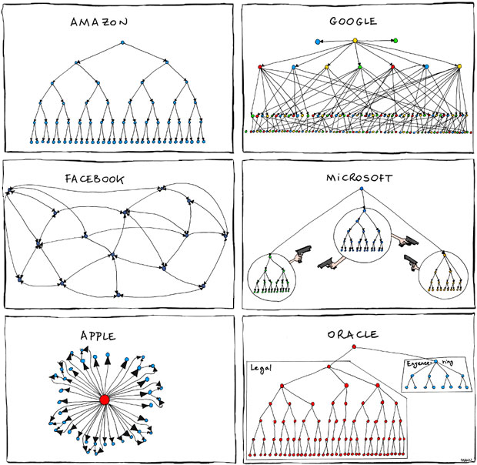
Great cloud services
Organizational charts
pic from xkcd.com
Notes:
Big boys have build great services.
Youtube and Gmail, Facebook, Dropbox, Tumbler and so on – we put our data online because it is great.
Nest, Alexa, Siri…
Limbonic Art → Simon and Garfunkel

Slide 5
Awesomeness of the cloud
Accessible everywhere
Back up online
Easy sharing and collaboration
All free!!!
  (or super cheap)
Notes:
Android phone breaks – log in on new
Games online
Chatting, sharing pics or documents with others
Free or cheap!

Slide 6
The awful cloud
Notes:
Last point – price. How do we pay?
Bad side of the cloud.

Slide 7
Awfulness of the cloud
Where is my data?
Who can access my data?
How is my data used?
Notes:
Ask yourself these questions.

Slide 8
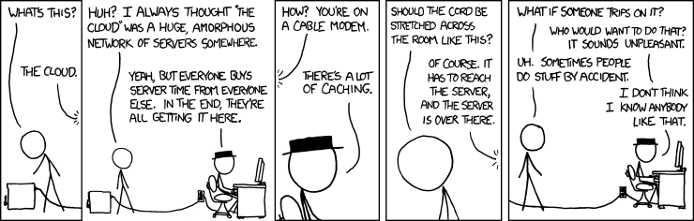
Where is your data?
Notes:
Your data is in the cloud – but that doesn’t answer much questions…
But the more important part is who has access.

Slide 9
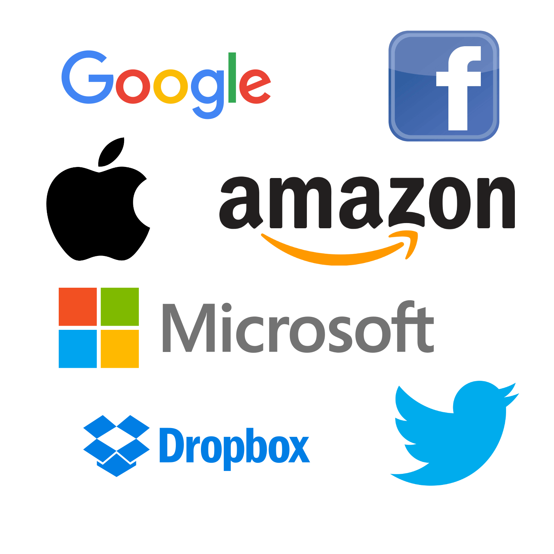

Where’s your data?
Notes:
2 years ago: Dropbox has been deleting copyrighted content.
Last year: Google has been deleting porn. The legitimate kind, created by porn stars for specific customers…
Starting May 1: Microsoft bans ‘offensive language’ and ‘inappropriate content’ from Skype, Office, ...

Slide 10
This thing called privacy
Notes:
Why it matters? Privacy, just that.

Slide 11
What do you have to hide?
You don't know!
You SHOULD have something!
Everybody needs privacy
Notes:
I have nothing to hide.
Well, you do. And you should. Besides, this isn't even the right argument to have.
Let's go over these three points

Slide 12
I - What do you have to hide?
So many rules and regulations...
Changing all the time!
Notes:
having things to hide:
27,000 pages of federal statues (4500 laws) or 10,000 administrative regulations in US.
possessing a live lobster
Being smelly in Washington
animal-rights activists criminally responsible for protests that cause the target of their attention to be fearful, regardless of the protesters' intentions. Congress passed the law in 2006 with only about a half-dozen of the 535 members voting on it. Often no Mens Rea (guilty mind)!!!
Cop with access to everything can take everything
And that is today.
We Dutch remember: largest % of jewish deported due to great records.
Believe me: you have things to hide.
You just don't know what.

Slide 13
II - What you should hide
No government is perfect
If government knew everything...
  Science
  Freedom
  Justice
  What’s next….
Notes:
steps forward often need ppl to hide information and people:
* think of every religion...
* Church access to notes Galileo
* civil dissidents & Jim Crow
* King George & USA independence
Slavery, gay marriage, sodomy laws, women rights...
Government is never perfect. Can't see difference between 'good' and 'bad' disruption

Slide 14

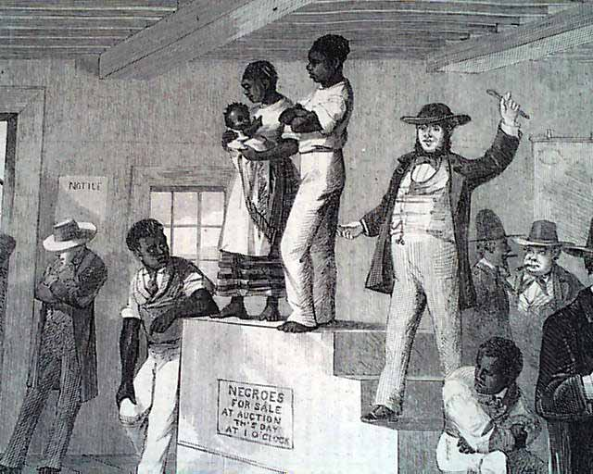
This was legal
Nazi concentration camps
Slavery

Slide 15
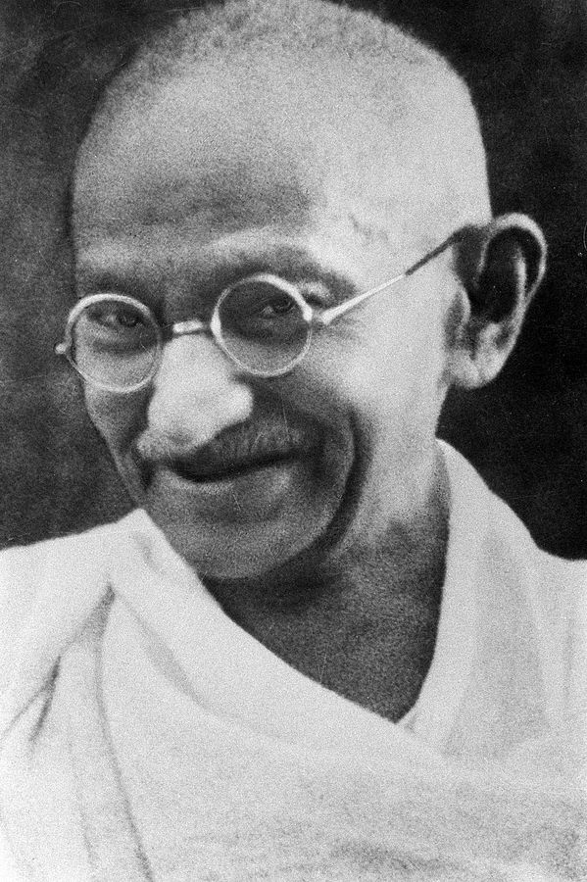
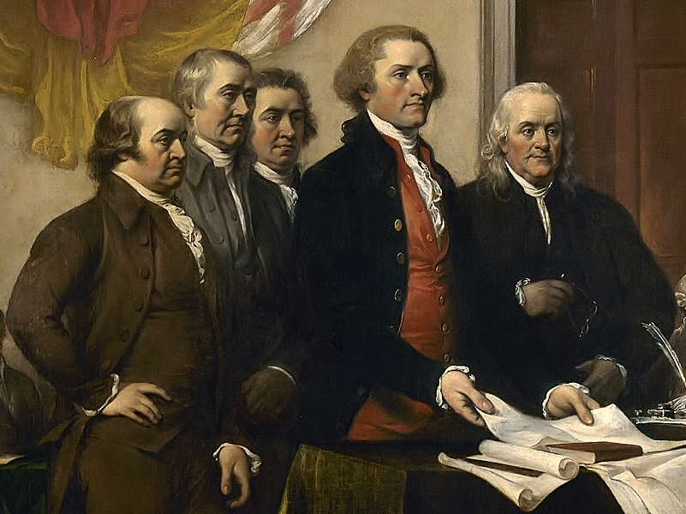
These are criminals
USA’s “Founding Fathers”
Mahatma Gandhi

Slide 16
III - It is a basic need
Control the impression you make on others
  Showers, Make-up, perfume, deodorant? Clothes?
All about 'saving face': who are you?
Notes:
Who in the audience ever needed a shrink? Yeah, you don’t like to talk about that...
How much do you care about how others see you? We all wear a mask most of the time.
Think dating, soliciting for a job...
On Facebook everybody is successful!
Without privacy, we lose the ability to present ourselves how we want.
It is a basic human need!

Slide 17
Who is safe?
"If privacy is outlawed,
only outlaws will have privacy."
- from the PGP manual
Notes:
You have, you should and you need something to hide.
Key: privacy eroded. Who gets hurt?
Not government
Not defense contractors, oil companies
Not big arms and drugs traffickers
Not well funded terrorists
They all have something to hide and thus invest resources to do so.
You, me, grass-roots political organizations
Annoying journalist? Annoying local charity?
Because they ‘have nothing to hide’ and thus are the ones who get hurt.

Slide 18
Getting back your data
Notes:
So, what do we do?

Slide 19
Decentralization
Control:
  Location
  Access rights
Security
  Open Source
Ease of use
Notes:
Federation of data: back to the early days of internet
Decentralized with a communication protocol
Own server or
Bittorrent-like protocols
Open Source

Slide 20
Decentralization protects
Just like real life:
  Use a good lock
  Keep it out of sight
  Don't keep it in one place
Notes:
Real life analogy – translates online.
* Use encryption
* Keep out of sight
iPhone: iCloud. Android: Google Drive.
* Not in one place
Google, Apple security super.
But too interesting for governments to demand, criminals to steal, companies to buy
Much value is in 'big data analysis': correlating, relating. Credit card details – one isn't much, 10K is interesting.
Millions of separate vaults: less secure each, but less interesting.
Think of real neighborhood!

Slide 21
Decentralization protects
"We are all vulnerable to everyone because the NSA wanted us to be vulnerable to them."
- Bruce Schneier
Notes:
One note, because it came up AGAIN. Keeps coming.
Police should have a back door.
No, they should NOT: decrease security for all.
Self-fulfilling prophecy: it is like suggesting to not lock our doors so that if a burglary is in progress the feds can more easily enter our house.
We have ONE infrastructure. There is no world where the US gets to spy but the Chinese can't.
We are all secure, or vulnerable.
An historic example is Greece: phone back doors for the government were used by criminals to target judges and kill them.
Backdoors are a BAD IDEA.

Slide 22
Take back your data
Notes:
You should be convinced now:
Cloud is awesome
But endangers privacy
And privacy matters
You know what you need: something you OWN.

Slide 23
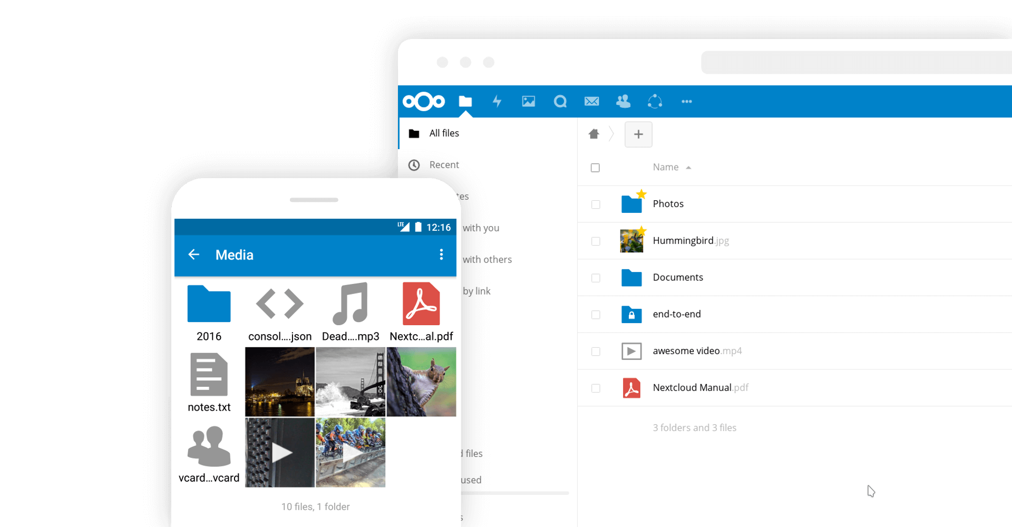
Introducing Nextcloud
Secure data
Private clouds
Cross-cloud sharing
Audio & video chat
Notes:
We need to own our data. And Nextcloud helps you do that.
Nextcloud is a file sync and share technology. You run it on your own server or pick one of the dozens of providers.
Both server and clients are open source and are developed with the goals of being easy to install, use and extend.
Nextcloud has tens of millions of users – by any metric I can think off we’re the biggest self-hosted cloud community.

Slide 24


Easy to use
Easy to deploy: LAMP
Easy to improve on or inspect: PHP, JS, CSS
All-platform access
Scale from Raspberry Pi to 20 mln users
Notes:
Easy is key. Nextcloud aims to be easy to deploy, use and keep secure, in every way. We pick ‘simple’ dependencies, even if they are less fancy or more work for us. We keep our UI uncluttered, even if some people want to add 1000 more features. We try to make security simple, telling admins what to do to secure their instance and warning users of unsafe passwords.
Nextcloud runs on anything from a Raspberry Pi to clusters with 20 million users.

Slide 25
Sync and Share
Multi-platform
External Storage
  FTP, NFS, WebDAV, dropbox, S3, …
  Encryption
  Versioning
Sharing
  Public links, passwords, expiring, upload rights
Server to server sharing
Notes:
External Storage
* FTP, NFS, WebDAV, dropbox, S3, …
* Encryption
* Versioning
Sharing
Friends took pictures at your wedding?
Send them a public link, expiring in 2 months, protected with a password for uploading files!
Server to server sharing
Federation and decentralization!

Slide 26
Extensible
~200 Nextcloud Apps
mail, calendar, music, password manager, chat, podcasts, notes… ...
apps.nextcloud.com
Notes:
Nextcloud is a platform you can build apps on
Over 200 available

Slide 27





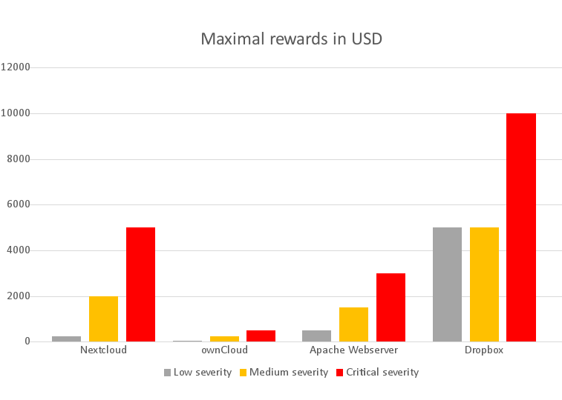
Security of Nextcloud
Documentation
Analysis/threatmodel
Reviews, tests
Security scans, CVE’s
Bug bounty program
Notes:
5K bug bounty

Slide 28
Yours
Open Source
Tens of Millions of users
  Over 1500 contributors, 600 in last year
  github.com/nextcloud
  Nextcloud GmbH for enterprise
Notes:
Most central point: YOU OWN IT.
Fully open
Development on github
AGPL
Etc.
Nextcloud GmbH offers a Nextcloud Subscription for companies, giving access to our development, security and support resources.

Slide 29
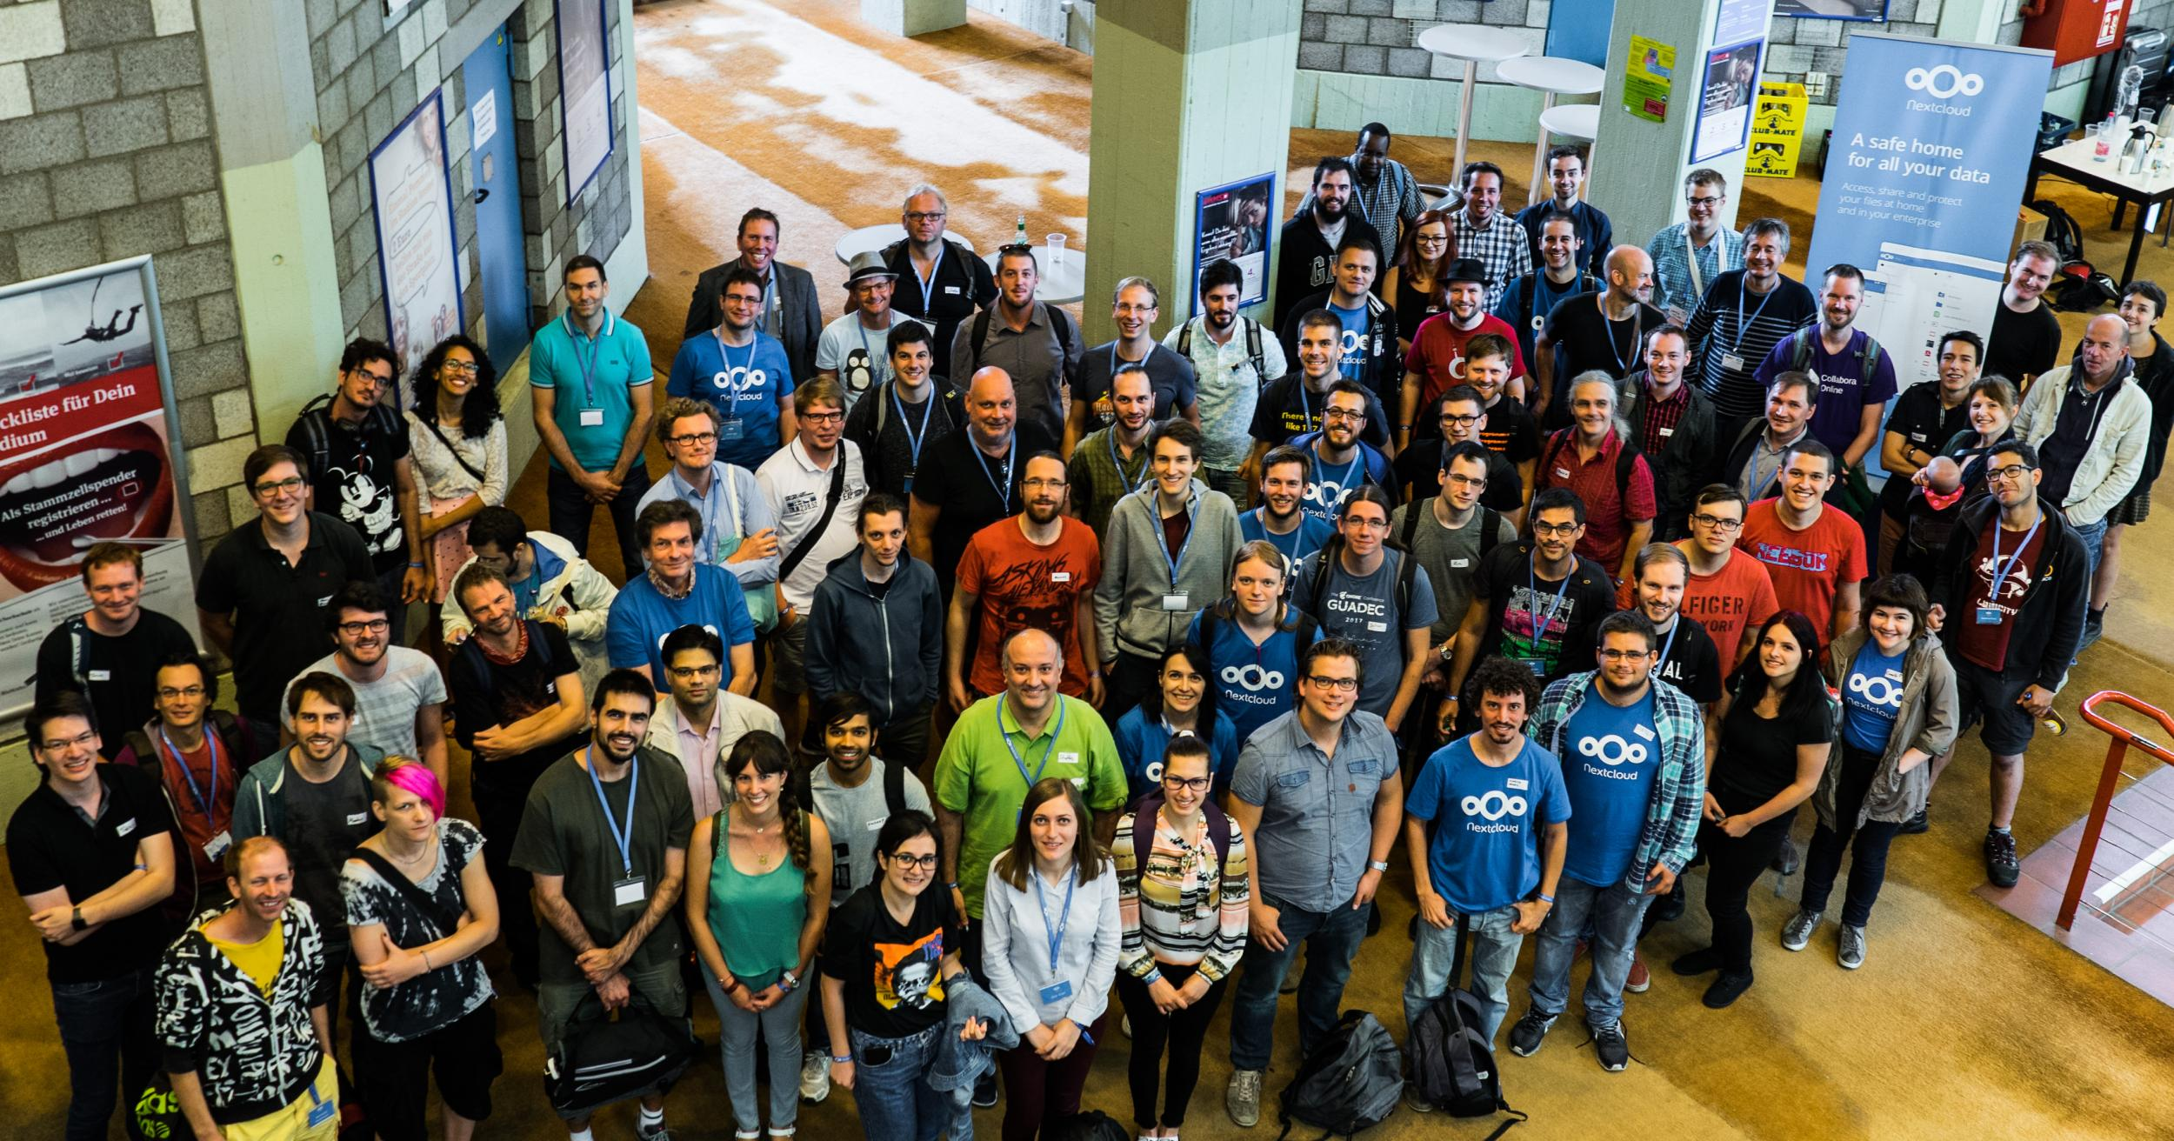
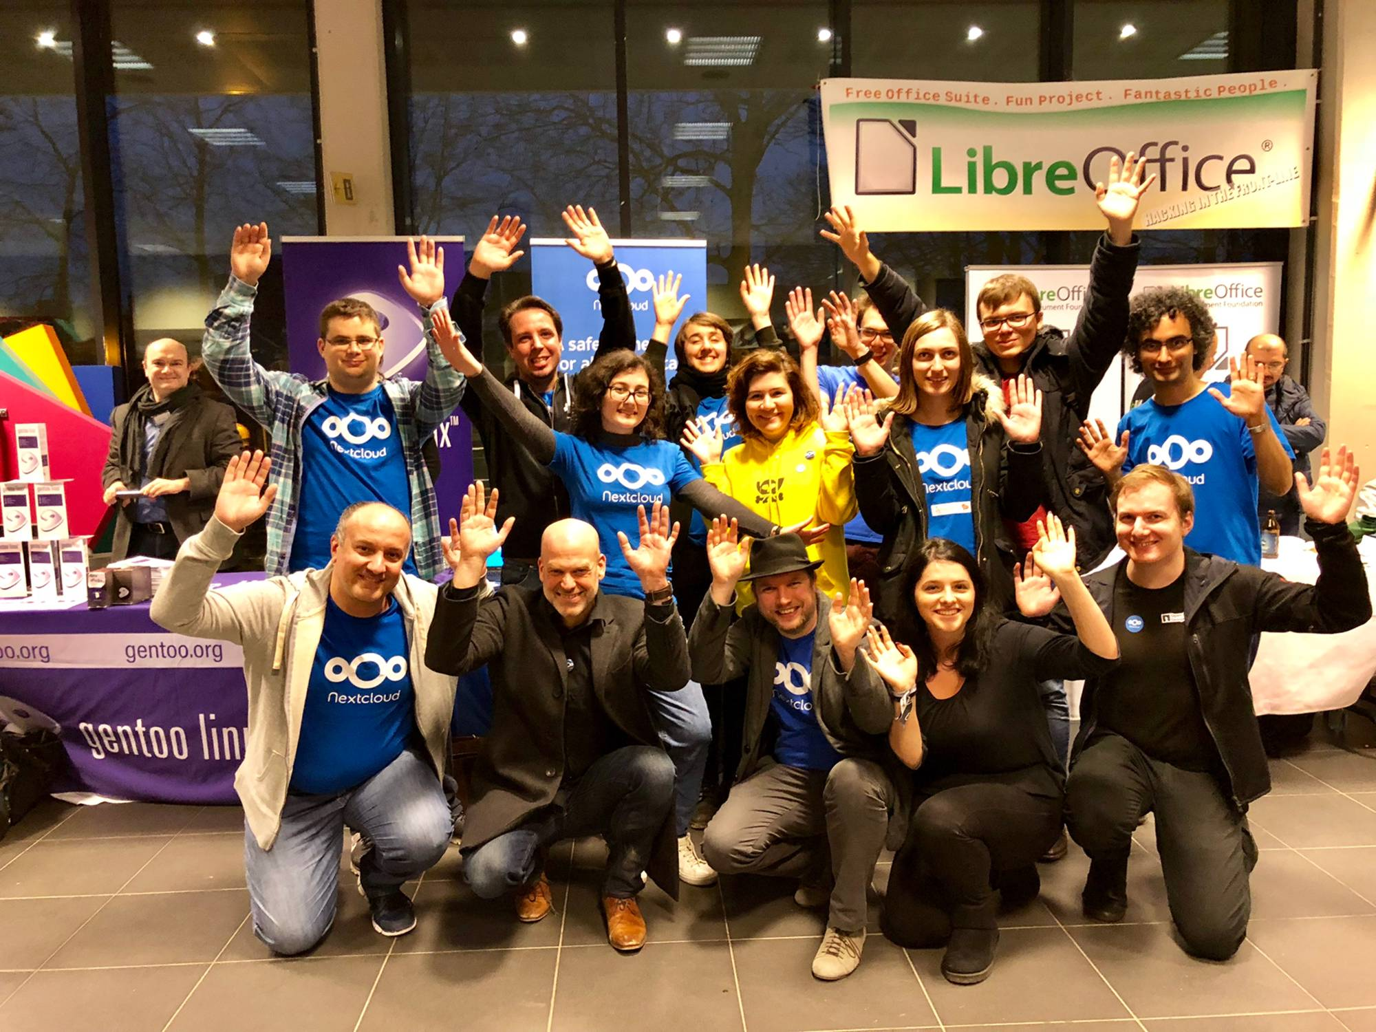
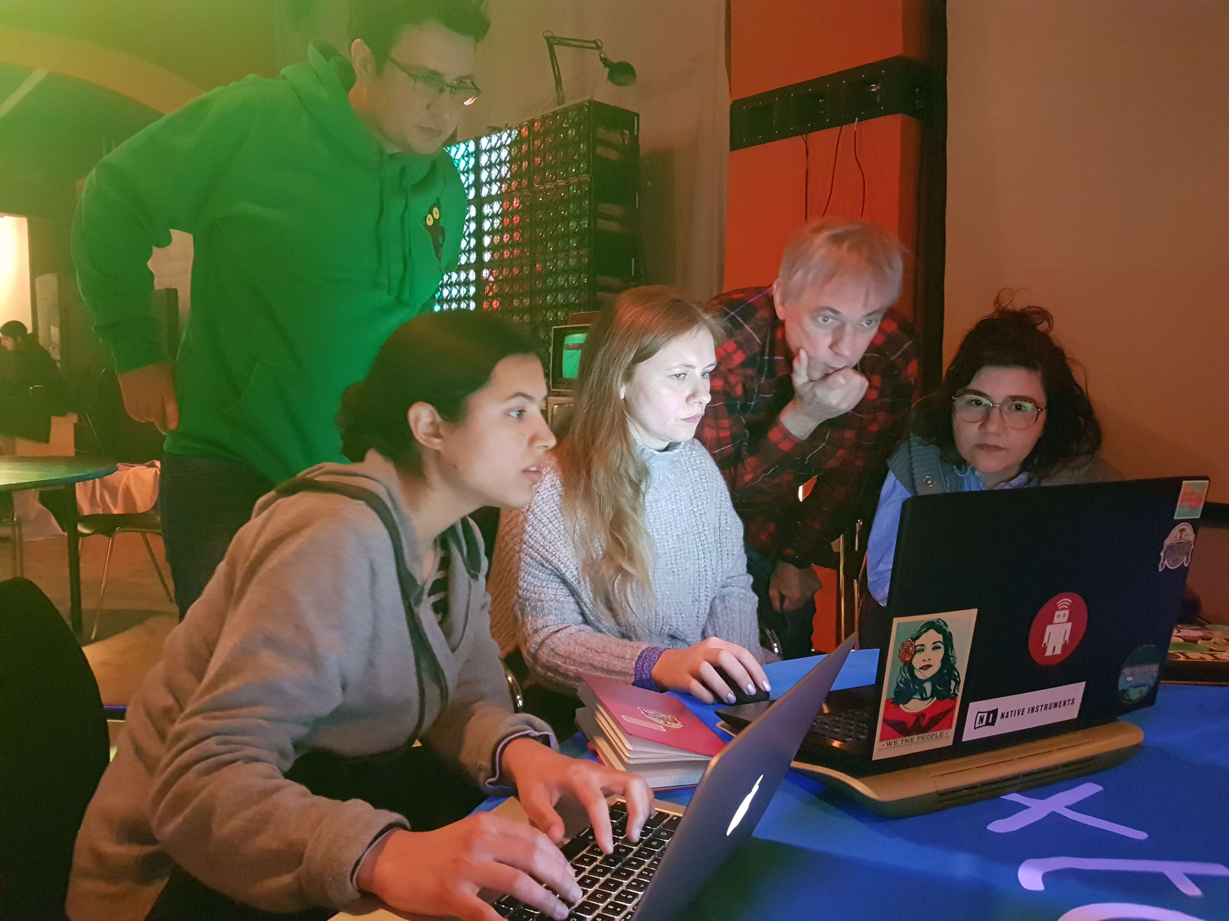
Notes:
200 ppl at conf
Visiting events
Mentoring like RailsGirlsSummerOfCode and Google Summer of Code.

Slide 30
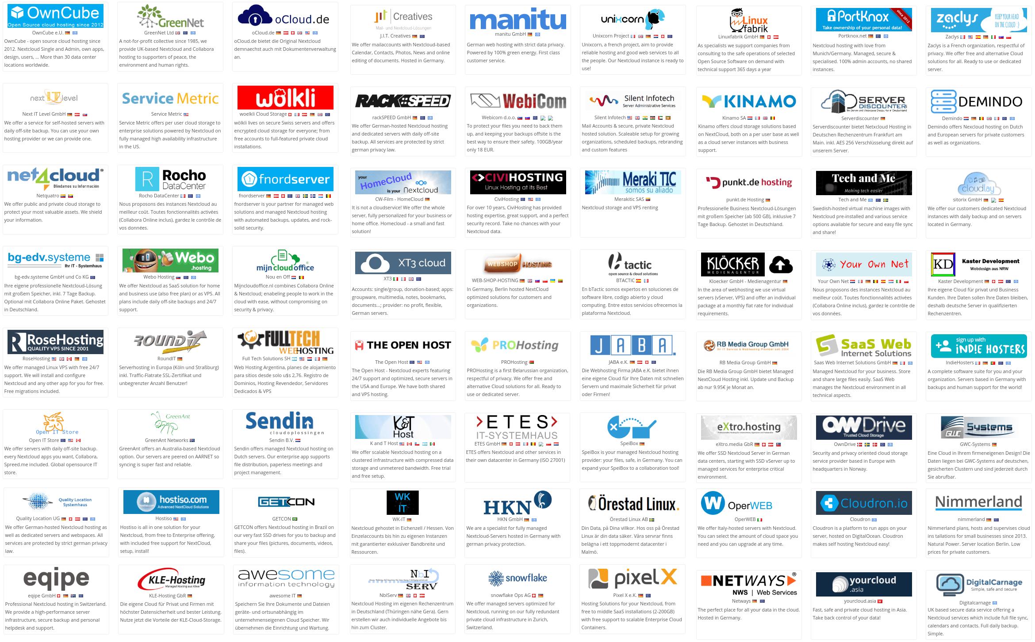
Over 100 providers
Notes:
Server == hard
Providers → decentralization

Slide 31
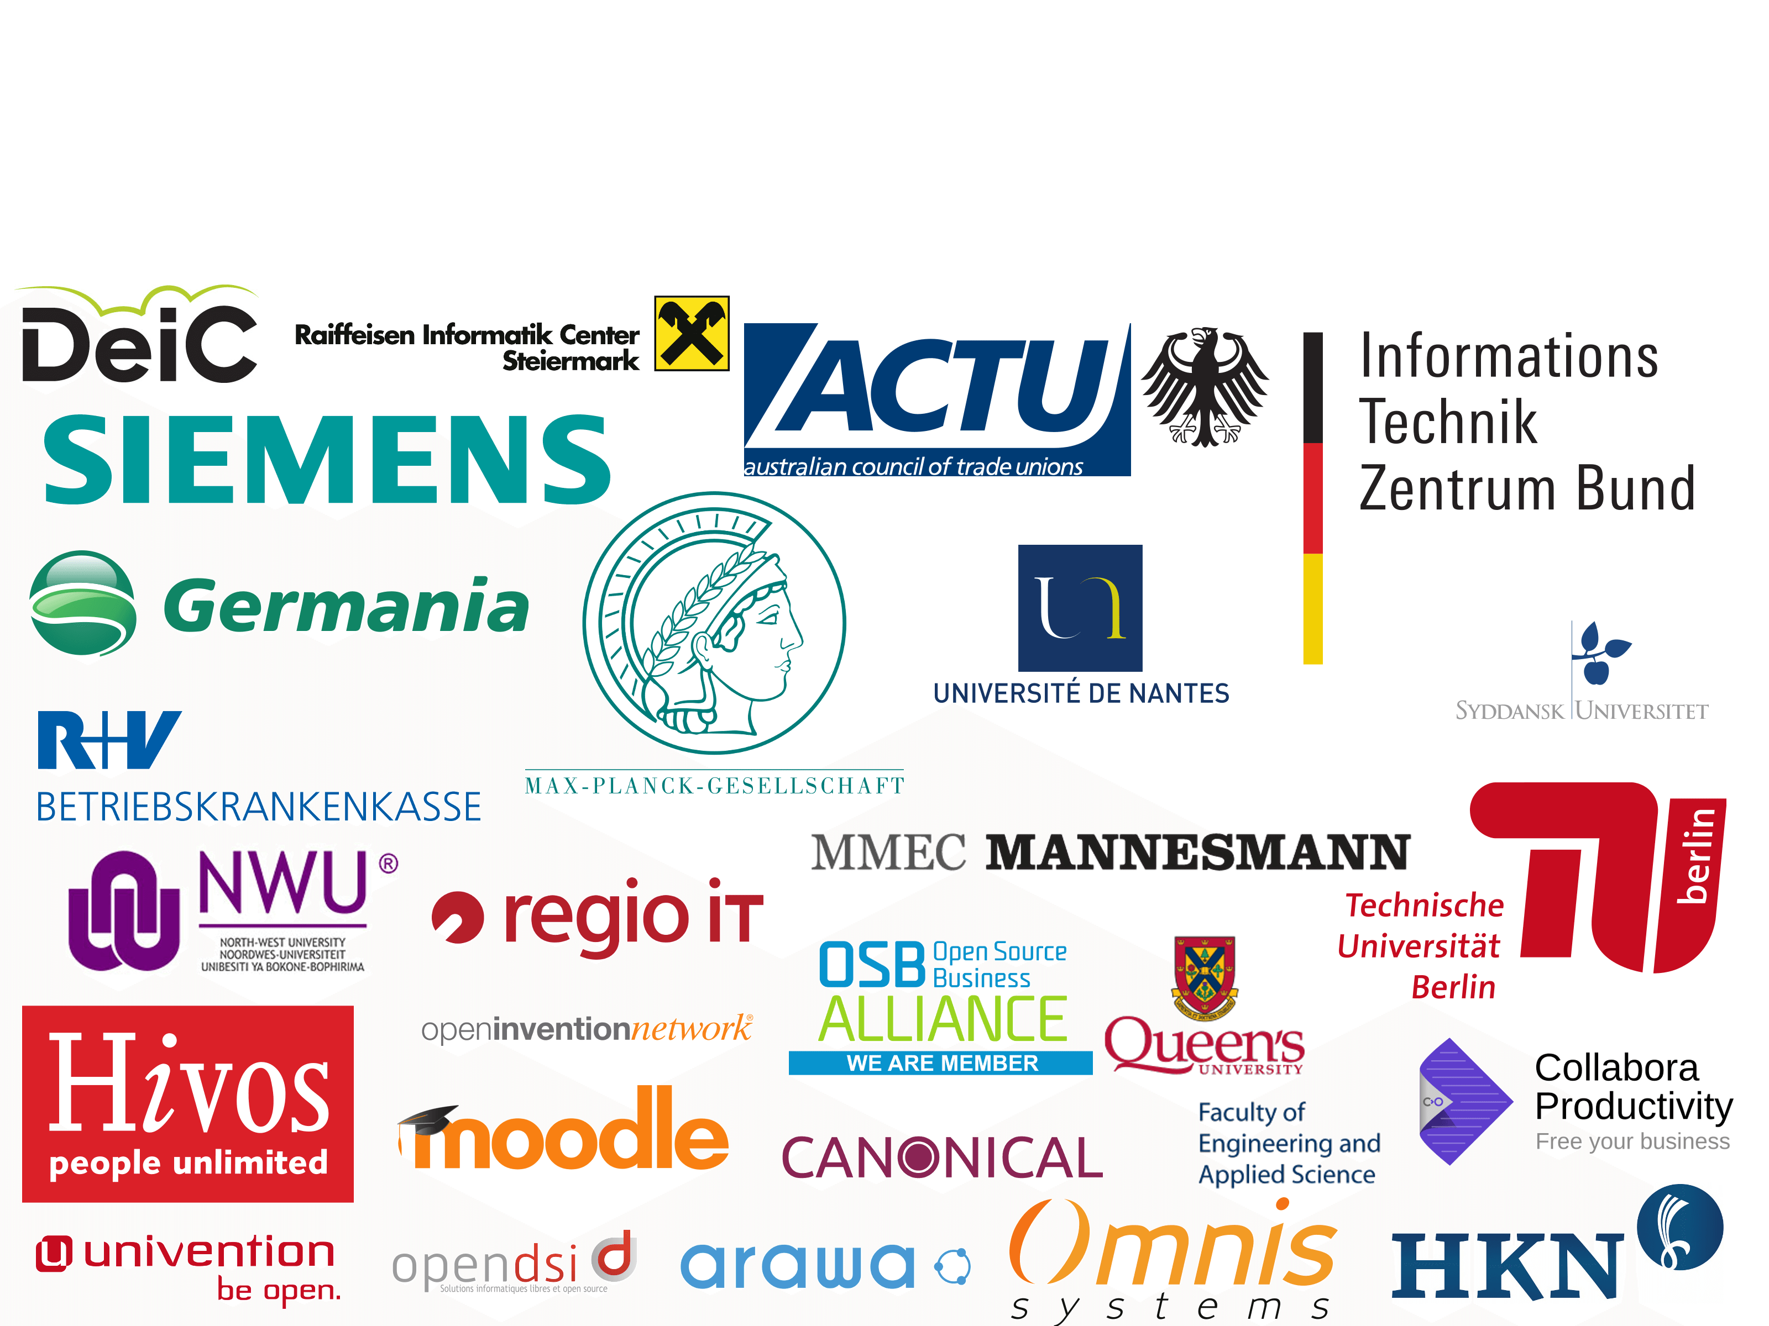
200 customers & dozens of partners
Notes:
As a business – Nextcloud GmbH helps you run your own Cloud.

Slide 32











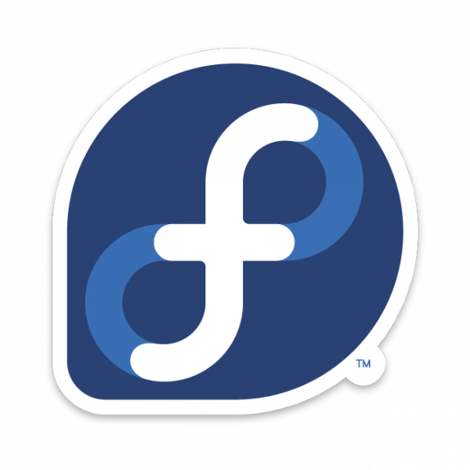






We’re not alone of course!

Slide 33
The 200 things
Authentication:
  2FA – SMS, Signal, Telegram, TOTP, Yubikey, U2F, OpenID, notification…
  SQL, CAS, ORCID
Storage
  Zimbra, Google Drive, Sharepoint
  Sia & Storj.io blockchain storage

Slide 34

Notes:
(buzzword bingo for those who just hit Blockchain)

Slide 35
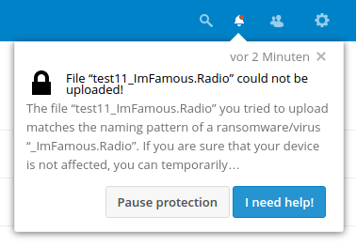
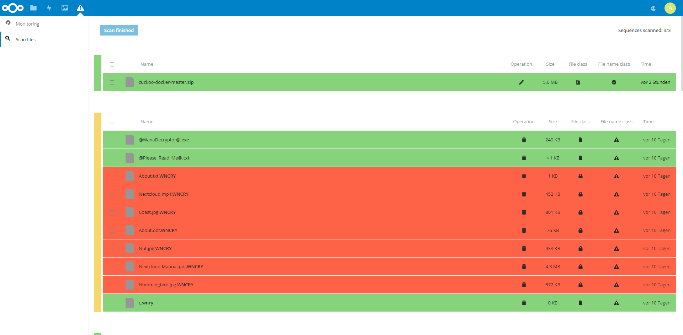
Security: ransomware
Notes:
University of Konstanz developed a Ransomware Protection app. Details here:
https://nextcloud.com/blog/fighting-ransomware-with-guided-undo-nextcloud-in-research-protecting-users/

Slide 36
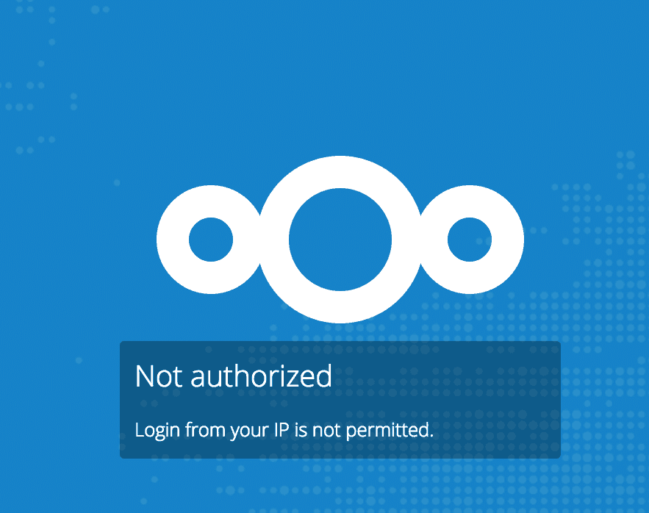
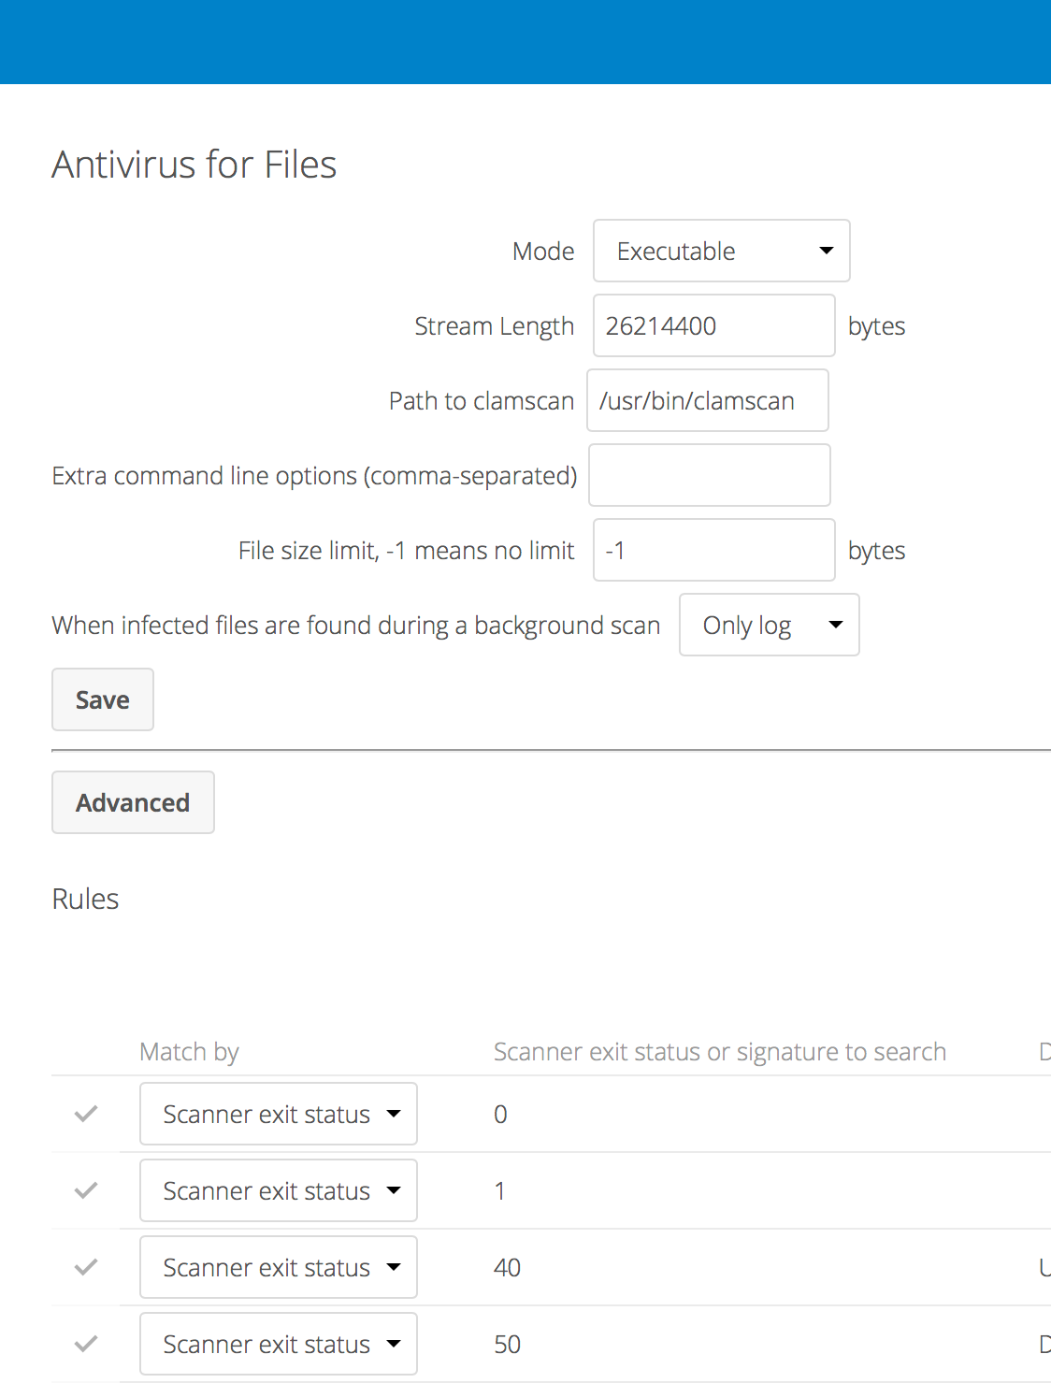
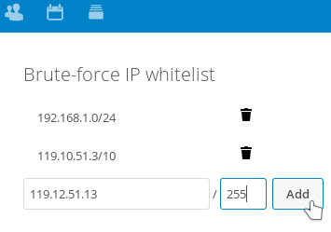
Security: tools
Notes:
Block access based on IP,
Manage brute force settings
anti-virus

Slide 37
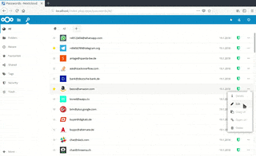
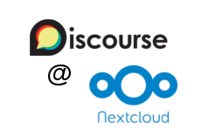

Security: applications
Plus - Keeweb / Keepass
Notes:
2 Password managers
Authenticate discourse through Nextcloud.

Slide 38
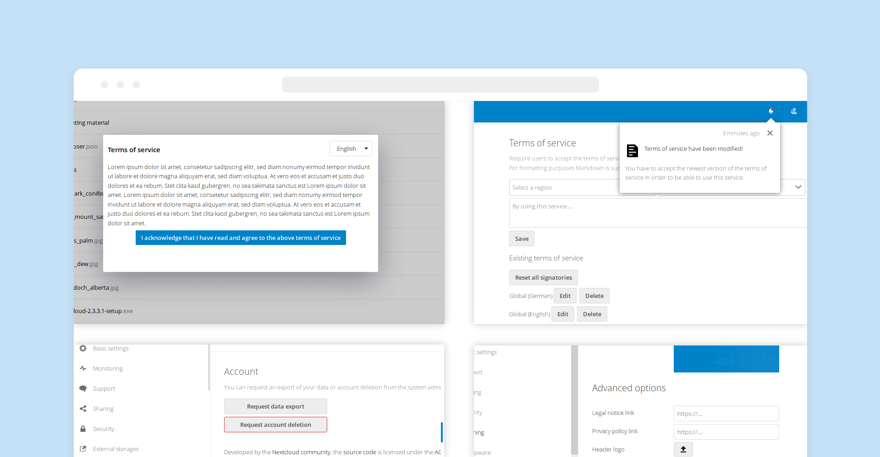
Security: GDPRBLSIVOMSD
Notes:
Loads of GDPR and other compliance apps, providing consent-question, letting users ask data and so on.

Slide 39
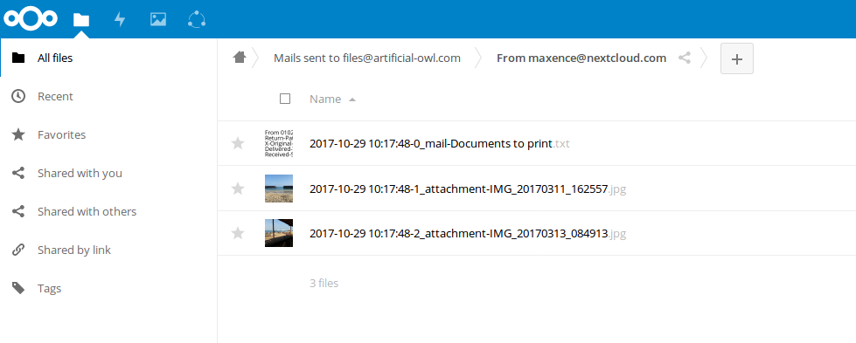
Files from mail
Notes:
Files-from-mail:
Configure an inbox – any attachments of mails sent there will be stored in your Nextcloud under a folder with the name of the sender.

Slide 40
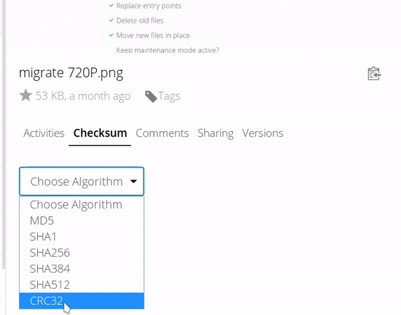
To0ls
Right-click
Menu re-order
Piwik/Mamoto tracking
File checksum
Metadata extractor
Scanner
Share renamer
Drop-it
Default link open
Generate previews
Admin notifications
Snapshots (btrfs, zfs, …)
Impersonate
OCR
Notes:
Many more cool tools like that.
Highlight Snapshots (btrfs/zfs etc): filesystem back-end for Nextcloud Versions!
OCR → turns images in text → for our full-text-search to index!
(full text search apps for apache solr and Elastic Search. Choice, of course)

Slide 41
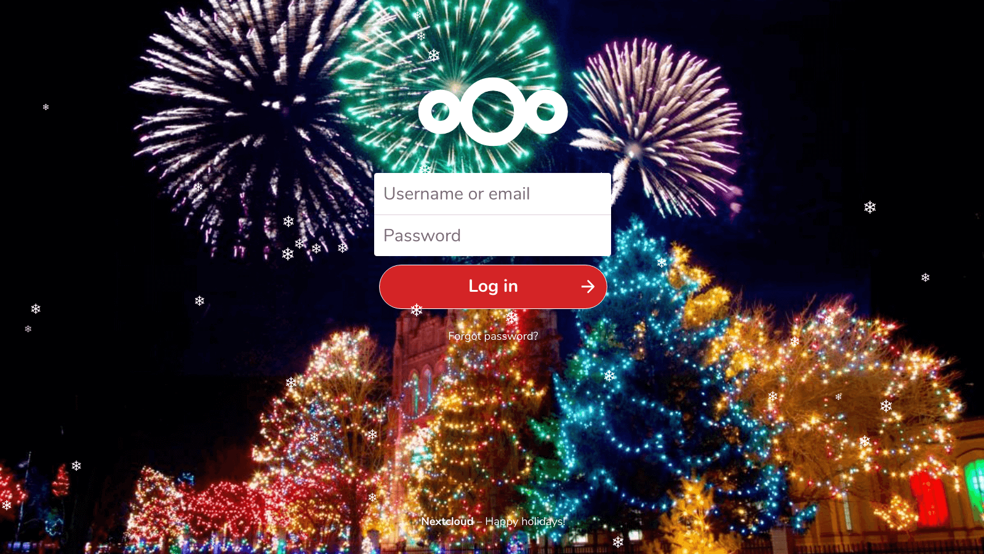
JSLoader
Notes:
And yes you can have snow in Nextcloud. Using the JSLoader app, which can load any type of javascript on all pages… also useful for analytics of course.

Slide 42
The ‘big’ apps
Notes:
Those were a bunch of ‘small’ apps and little tools. Now a few ‘big’ ones.

Slide 43
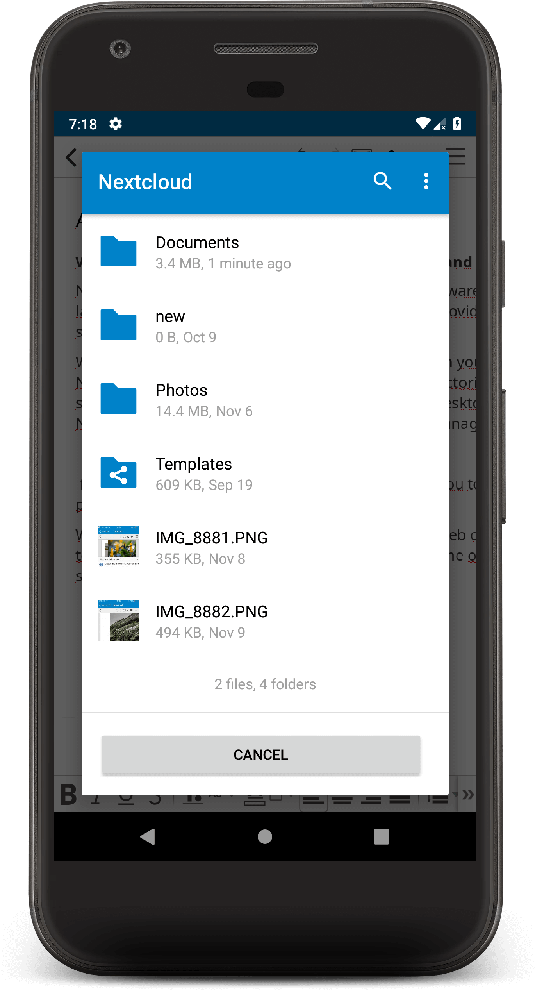
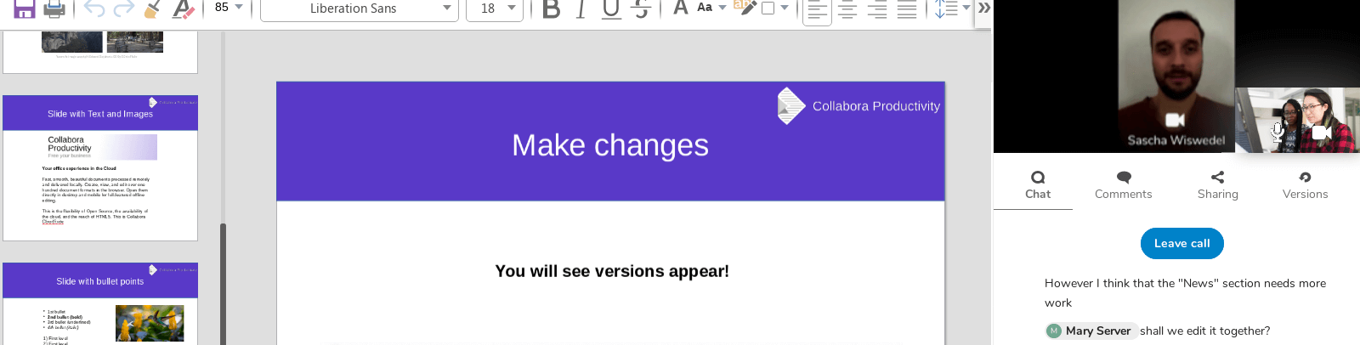
Collaboration
Audio/video chat
Document editing
Comments & notifications

Slide 44
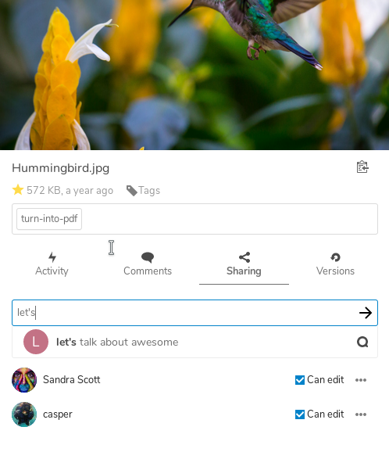
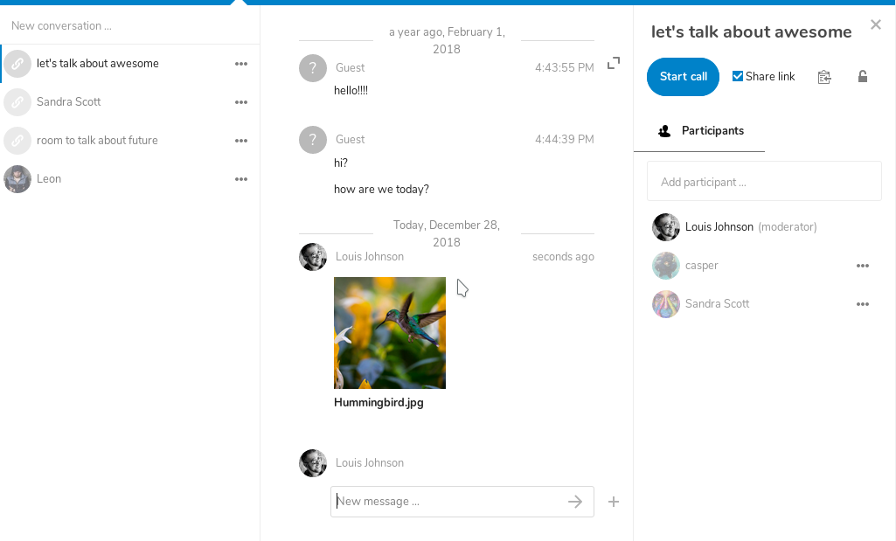
Integration
Notes:
These apps are well integrated:
Share a file directly to a chat, or attack a file to tasks

Slide 45
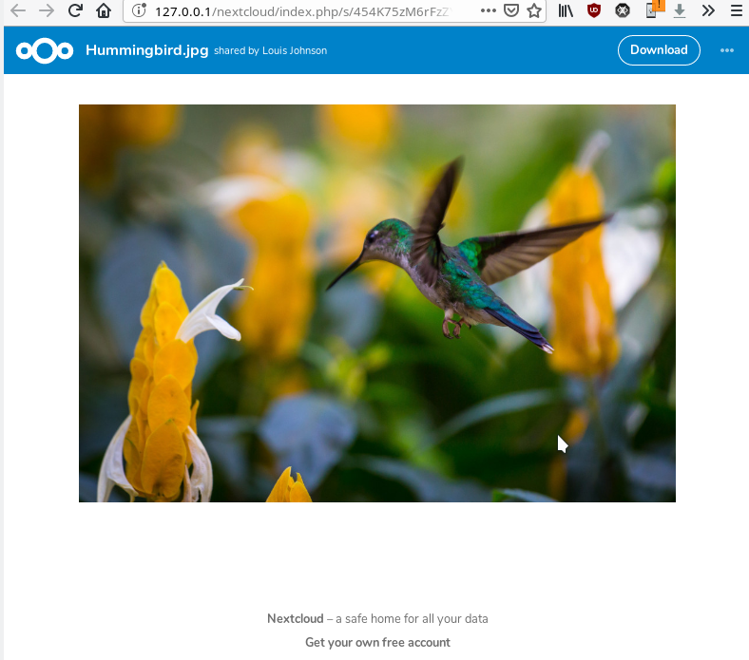
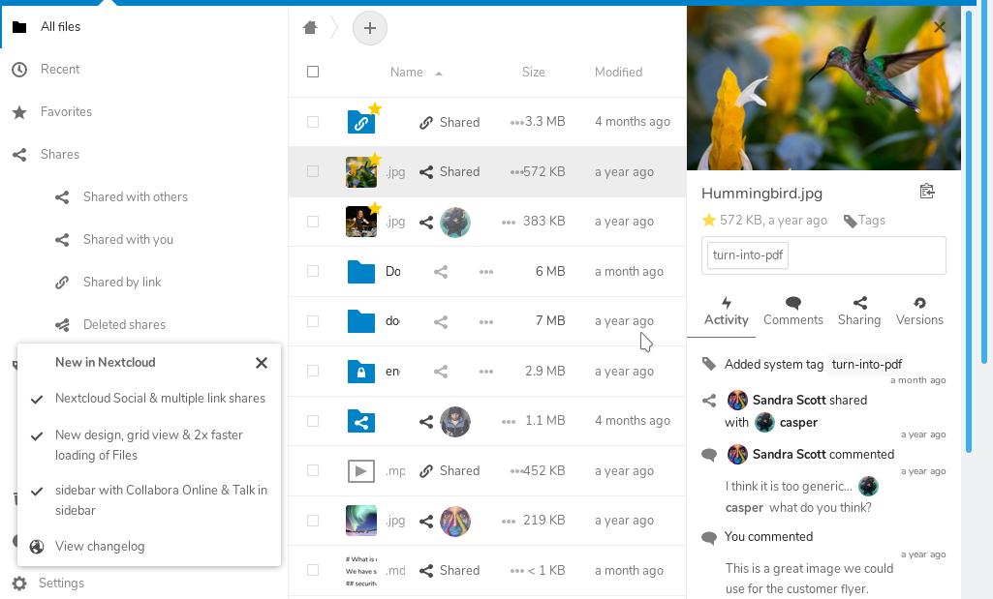
Be clever: private/public links
Notes:
And it is clever: if you share a conversation via a public link, the participants can open files. When they’re users on your server, the file is shared with them in their file list. But guests get a public link if they click the same file!

Slide 46
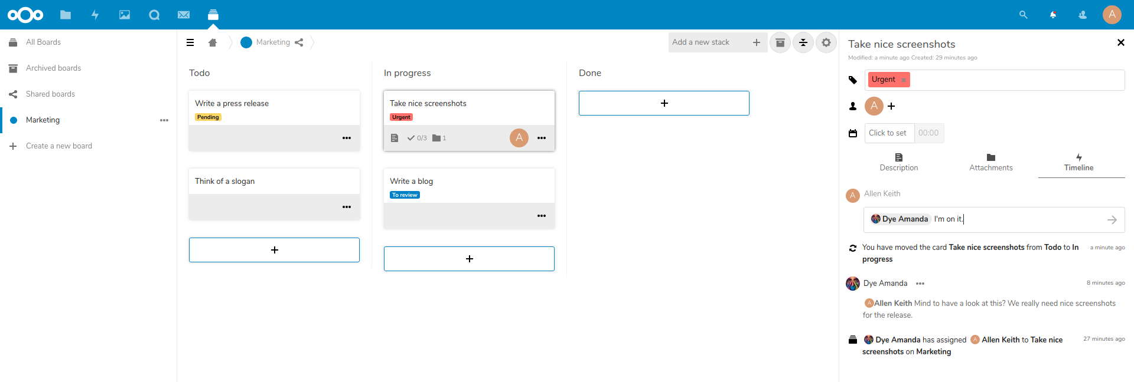
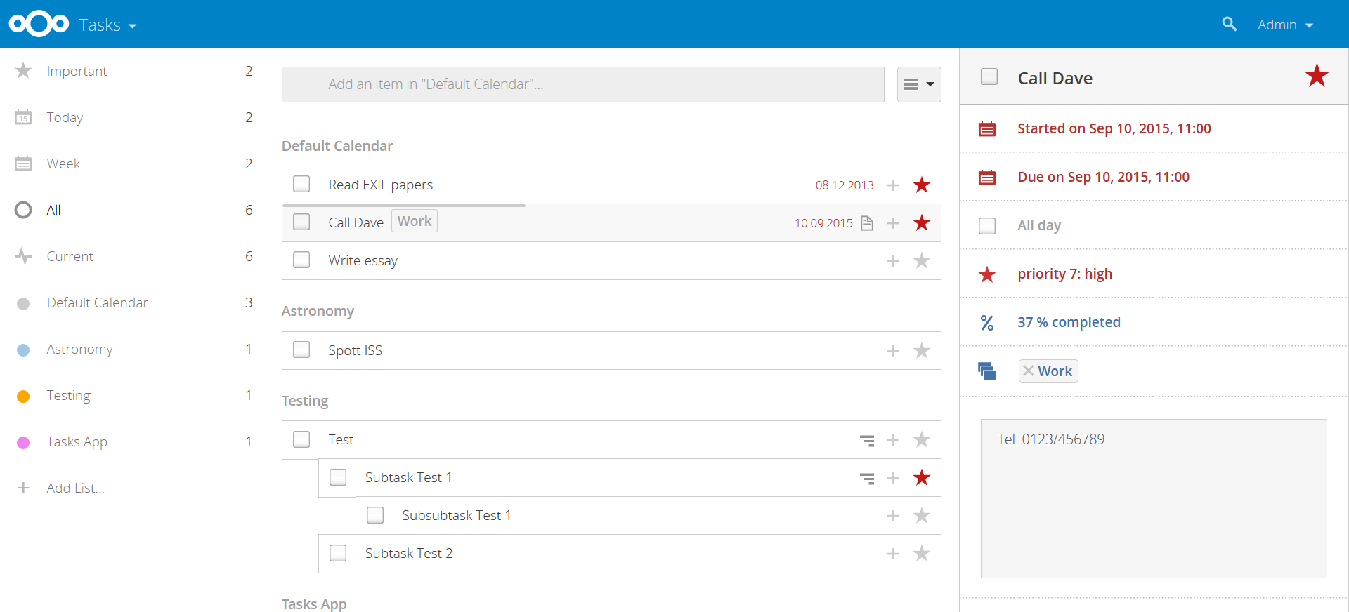
Productivity
Deck – kanban
Tasks
Note taking apps
Calendar
Contacts
Mail

Slide 47
More apps
OCDownloader
Music, Radio
Weather
Github merge tracker
Phone sync: sync sms
FBSync: get your data from facebook
Bookmarks
Ebook reader
OPDS Catalog
Javascript XMPP chat
Notes:
“OPDS is a syndication format for electronic publications based on Atom and HTTP which makes it possible to access those publications (which are not limited to electronic books) on any OPDS client device. Examples of the latter are phones and tablets running OPDS-compatible book readers, eg FBReader/CoolReader/Aldiko on Android or Marvin/KyBook/Stanza on iOS.”

Slide 48
Some highlights

Slide 49
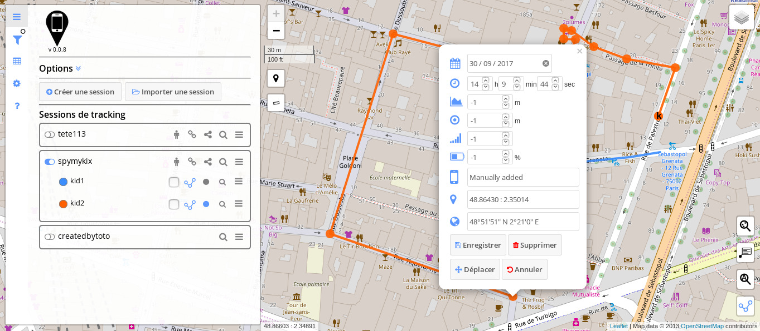
PhoneTrack
📱 PhoneTrack is a Nextcloud application to track and store mobile devices locations.
🗺 It receives information from mobile phones logging apps and displays it dynamically on a map.

Slide 50
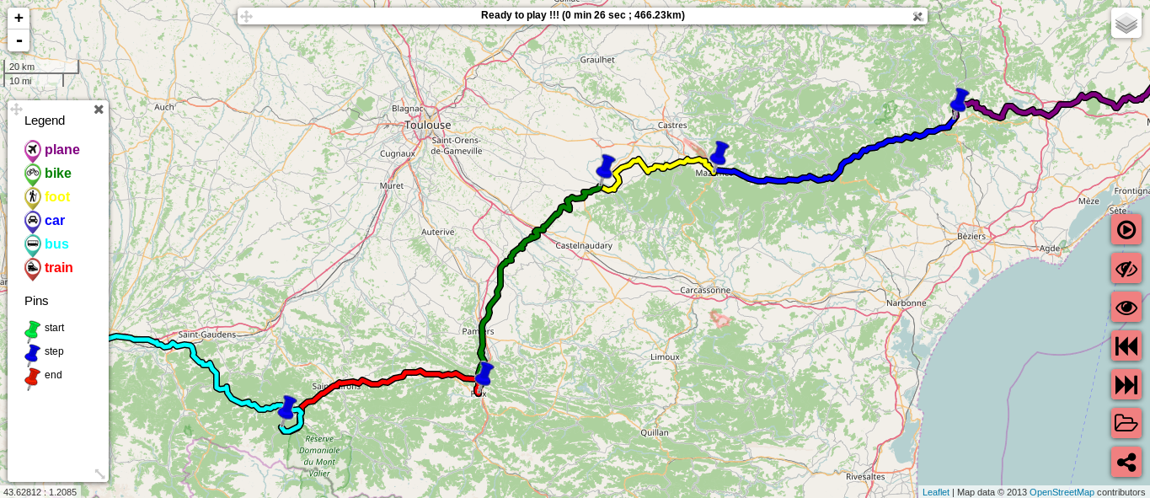
GPX-*
Notes:
Display, analyse, compare and share gpx tracks
Also edit & animate!

Slide 51
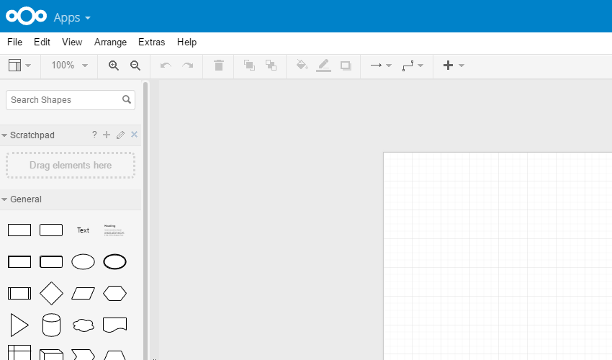
Draw.io

Slide 52
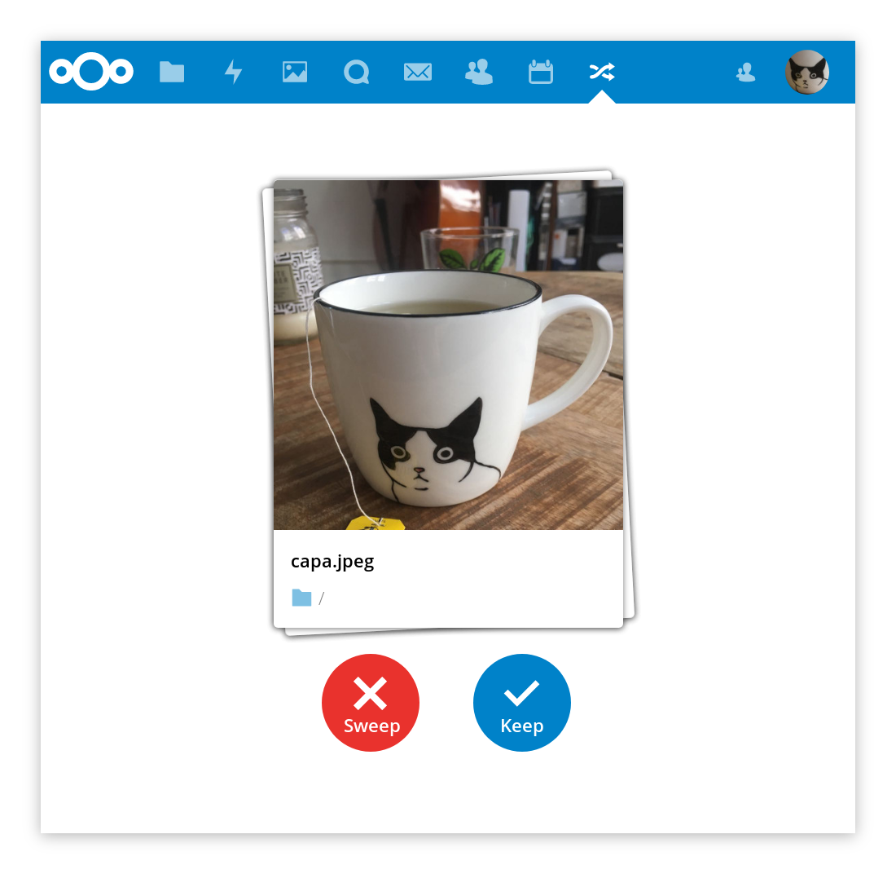
Notes:
Keep’n’sweep shows you a random file and lets you delete or keep it by hitting the right button. Also – its developer made hardware buttons that work with it!

Slide 53

DICOM viewer
Notes:
Dicom files are used by radiologists to view your brain ;-)
Nextcloud supports it and there are indeed radiologists who use this app.

Slide 54
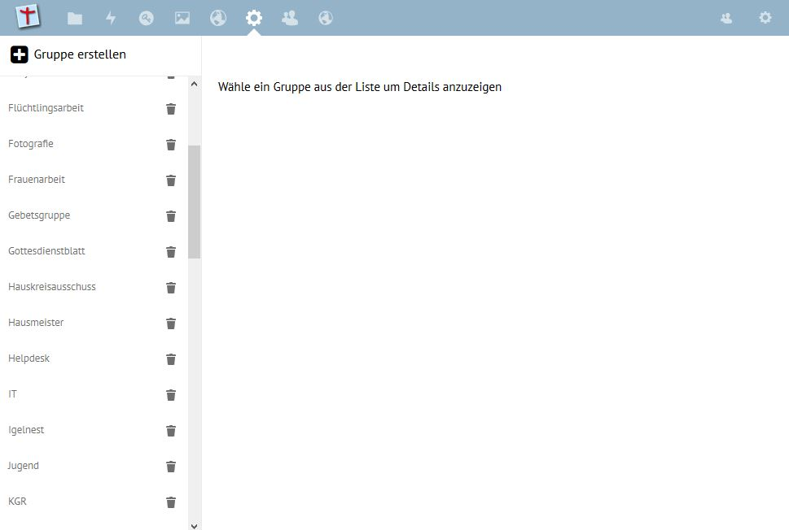
LDAP management
Notes:
Our normal LDAP is read-only but there are apps that let you manage LDAP users from within Nextcloud.

Slide 55
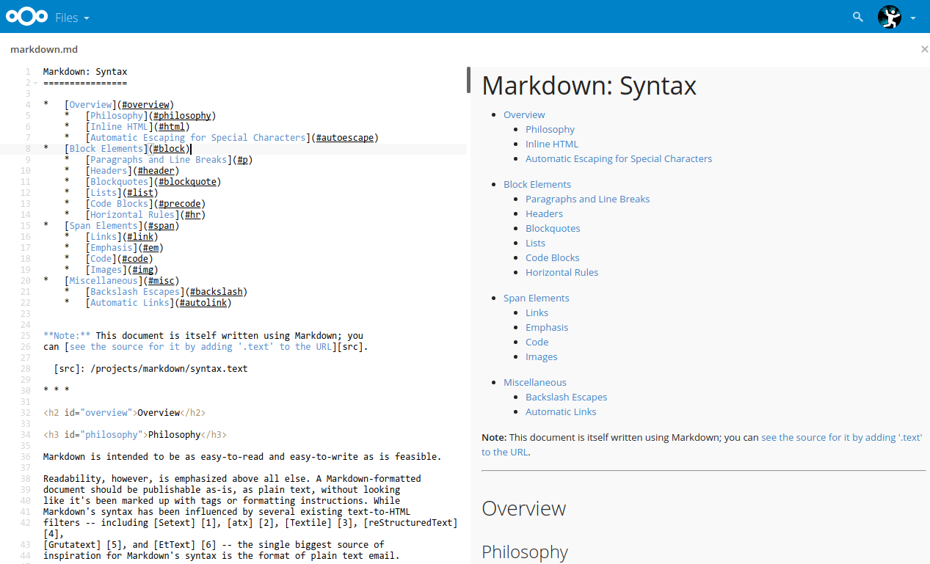
Markdown editor
Notes:
The Markdown editor lets you edit markdown files, showing a preview.
If you share a public link, it shows a preview to the visitor, complete with images and all mark-up! Great way to share things.

Slide 56
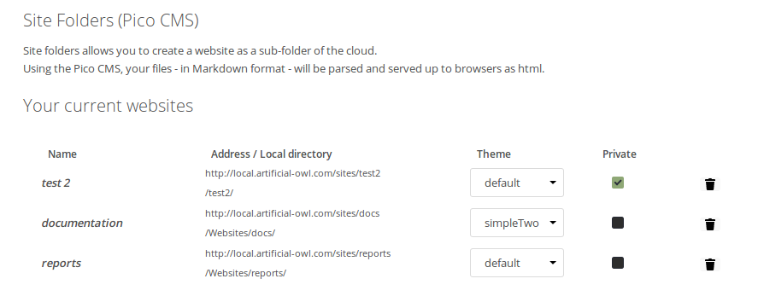
Website builder
Notes:
If just a nicely looking public link is not enough, you can build simple web pages with Pico CMS – a folder structure with Markdown files that can be accessed as website from the outside and collaborated on with a team. Nice for a wiki for example (it can be kept private of course)

Slide 57
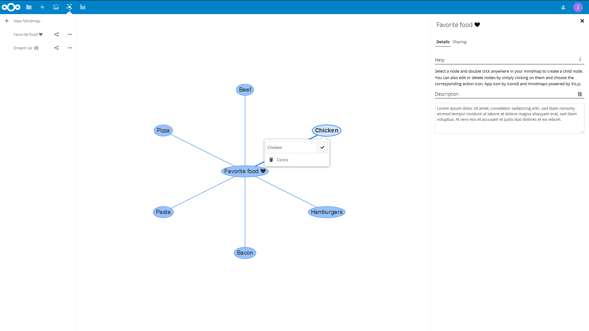
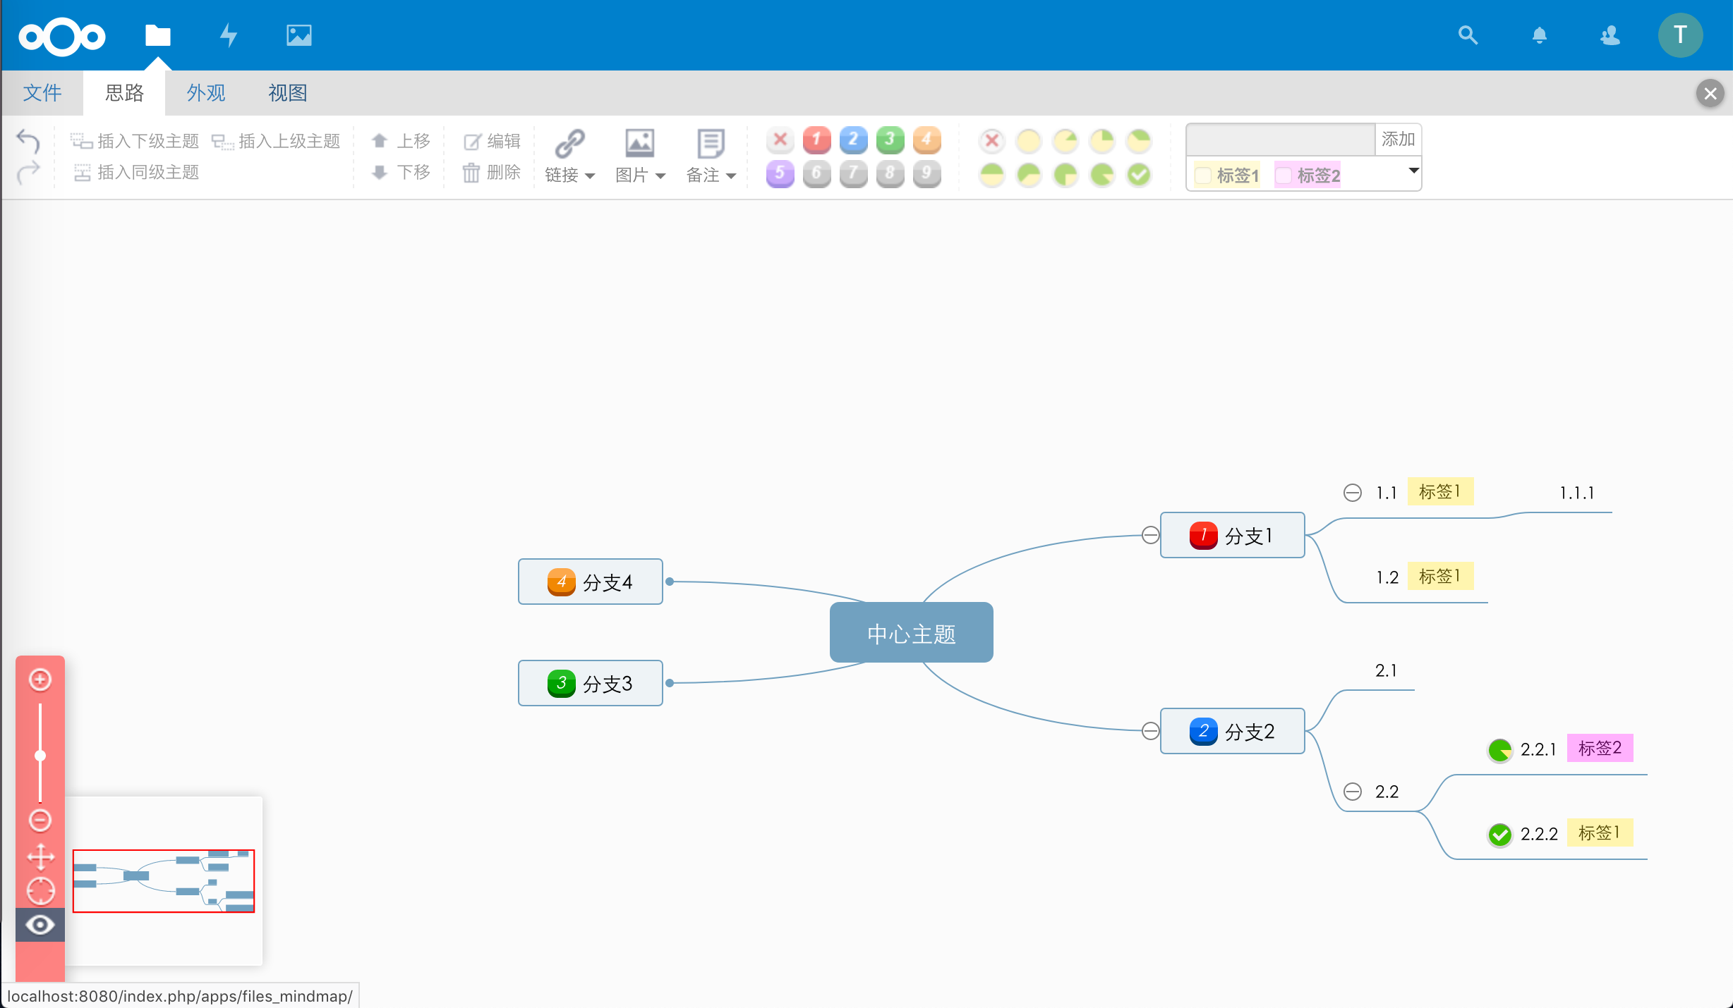
2x mindmaps

Slide 58
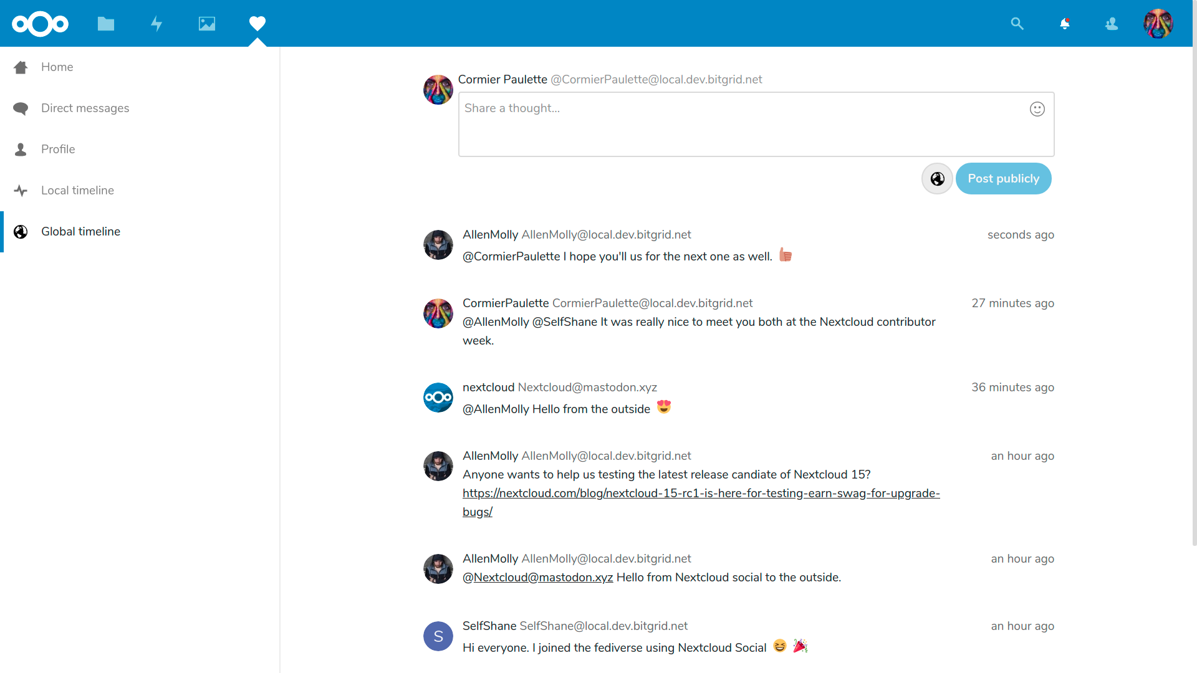
Nextcloud Social
Notes:
We’ve join the Fediverse!
https://nextcloud.com/blog/nextcloud-introduces-social-features-joins-the-fediverse/

Slide 59
Things you didn’t know

Slide 60
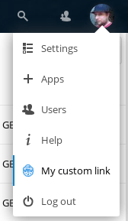
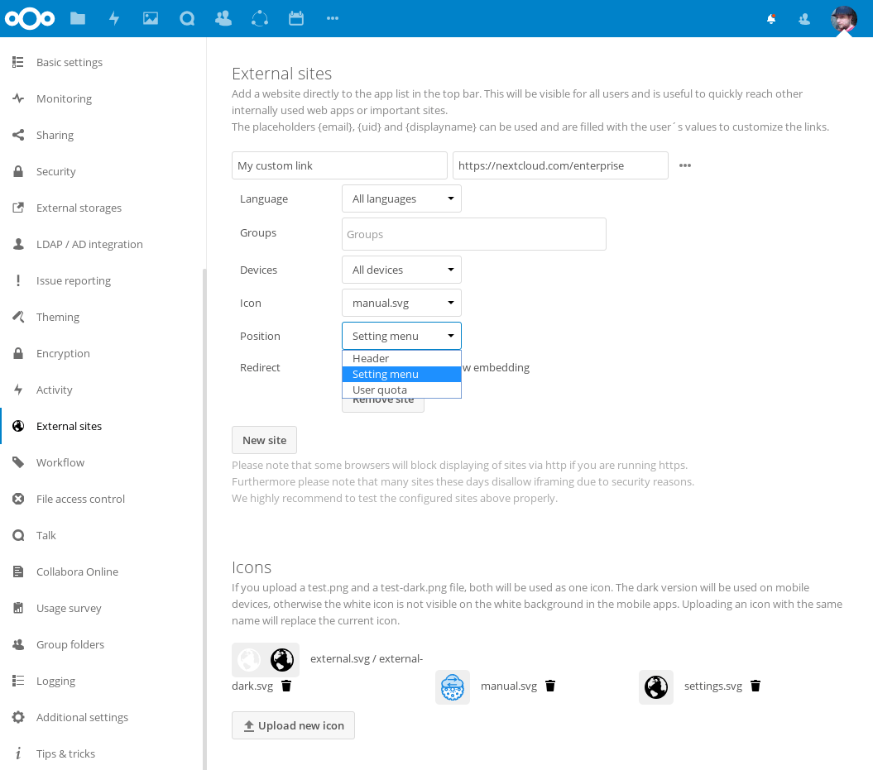
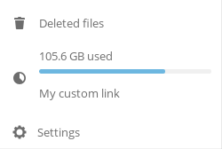
External sites
Notes:
You can add external sites in the top bar.
But not just there:
* you can have them in the user menu
* or just below the used space in the left
* and they can show up depending on user language so each user gets the page(s) he/she can read

Slide 61
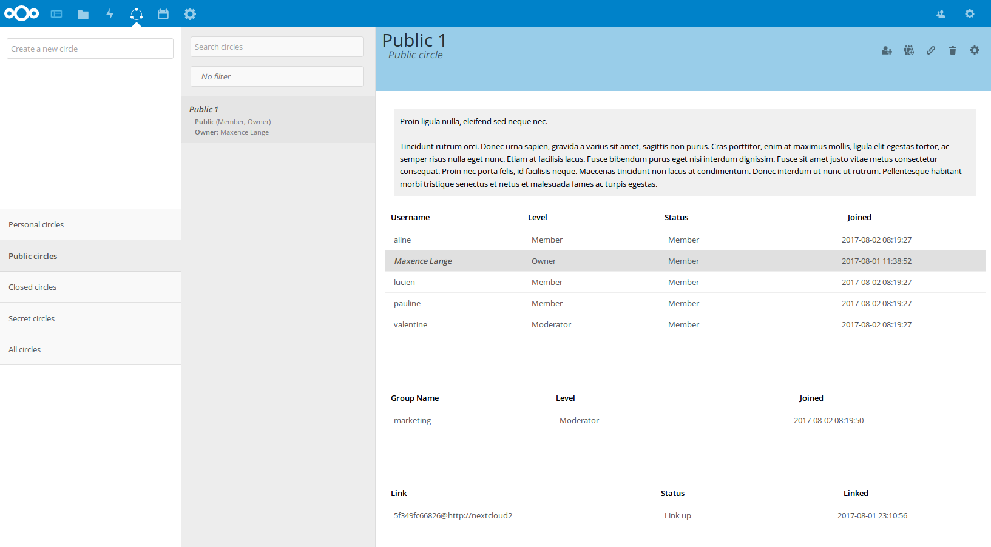
Groups
Notes:
Try out our group management app ‘circles’: users can create their own groups, public or private, and share and collaborate with them.

Slide 62
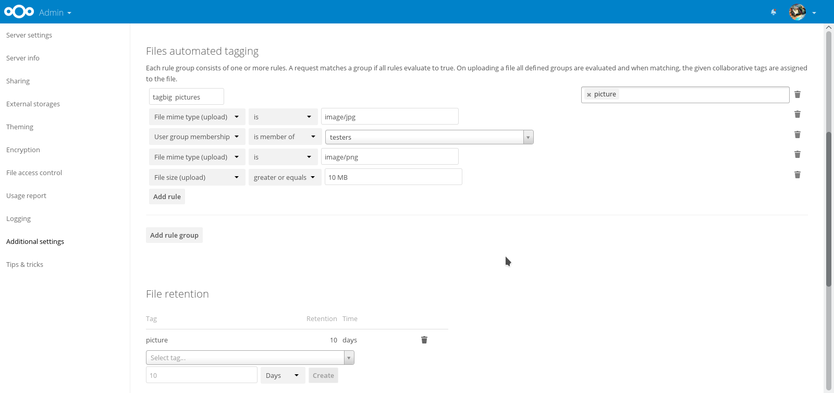
Automated tagging
Notes:
So then there’s the whole ‘workflow’ thing.
Basics: you define some rules, when match on upload: set tag.
* file size
* file type
* IP range
* user/group
* client
* ...

Slide 63
Now what?
Notes:
What to do with the tags?

Slide 64
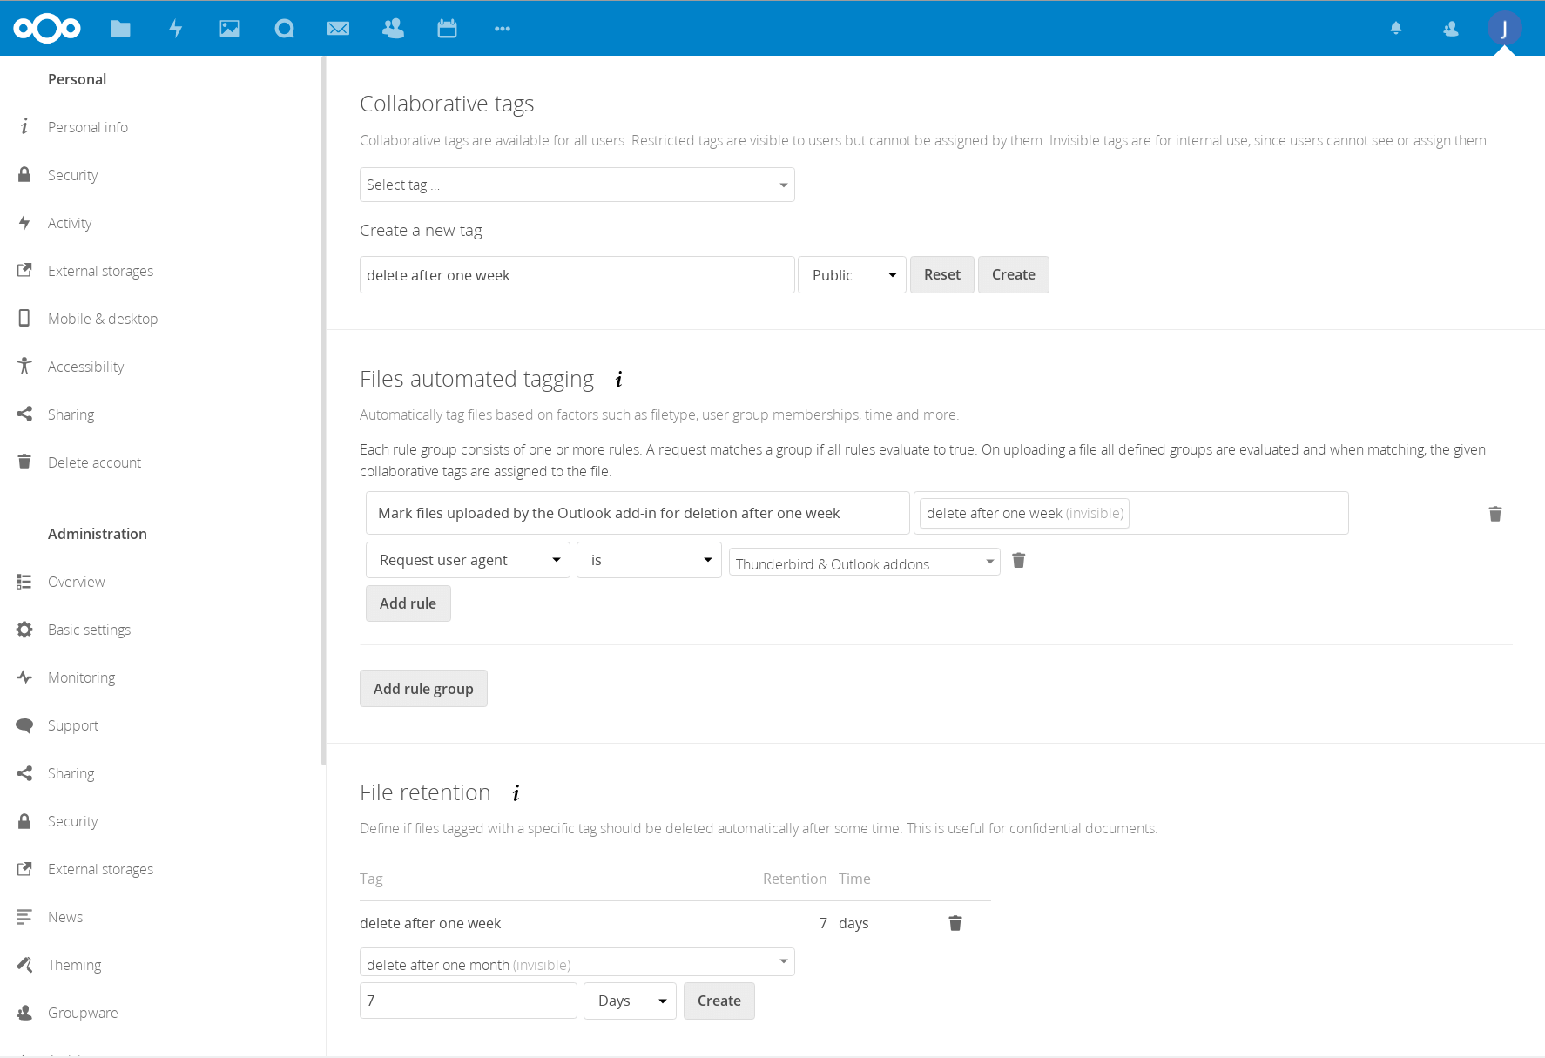
Notes:
Then what to do?
Set the retention of files uploaded by the Outlook add-in: delete files after X days.

Slide 65
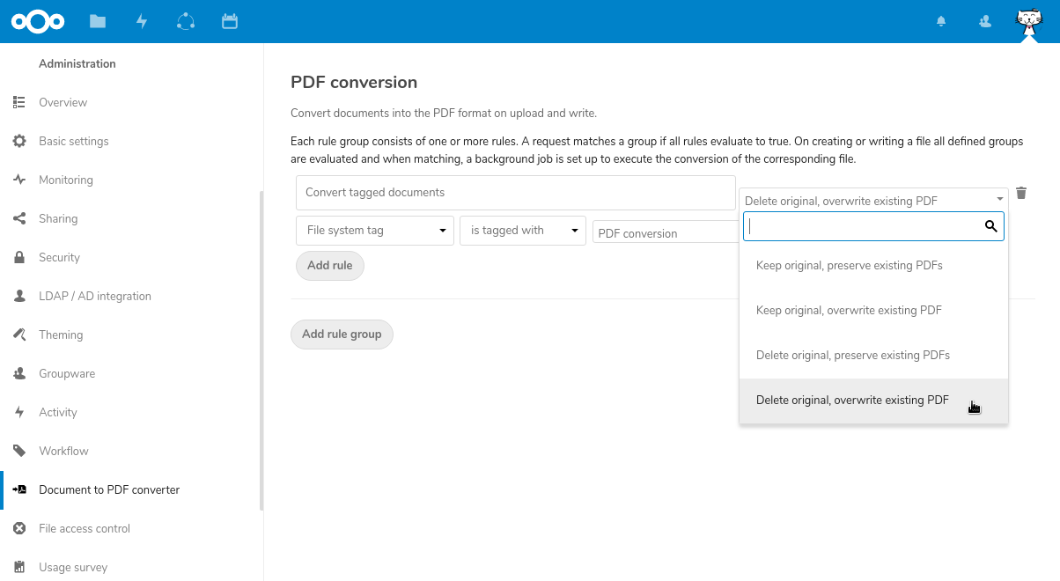
PDF conversion, scripts...
Notes:
Or convert the files to PDF. Or run scripts on them.
Posibilities are unlimited if you can do a bit of PHP ;-)

Slide 66

File Access Control
Notes:
Tags can also be used to limit access to Nextcloud: a file firewall that blocks, for example, people from outside a certain range of trusted IP addresses to see PDF files shared by the HR department.

Slide 67
Yeah, there’s more but we’re slide 67...

Slide 68
Get started today!
nextcloud.com/install
nextcloud.com/contribute
nextcloud.com/devices
nextcloud.com/providers
nextcloud.com/enterprise

Slide 69
That's it!

